Slide 1


Integrating NVIDIA Deep Learning Accelerator (NVDLA) with RISC-V SoC on FireSim
Farzad farshchi, Qijing huang, and Heechul yun
Energy Efficient Machine Learning and Cognitive Computing (EMC2), 2019
Presenter: Constant (Sang-Soo) Park
http://esoc.hanyang.ac.kr/people/sangsoo_park/index.html
September 23, 2020
Neural Network Acceleration Study Season #3

Slide 2
Contents of presentation
Introduction and Background
Motivation, Background knowledge
Key contribution: LLC + Memory Model
System-on-Chip (SoC) architecture
Memory configuration for optimized computing performance
Performance
Conclusion and Discussion
Neural Network Acceleration Study Season #3

Slide 3
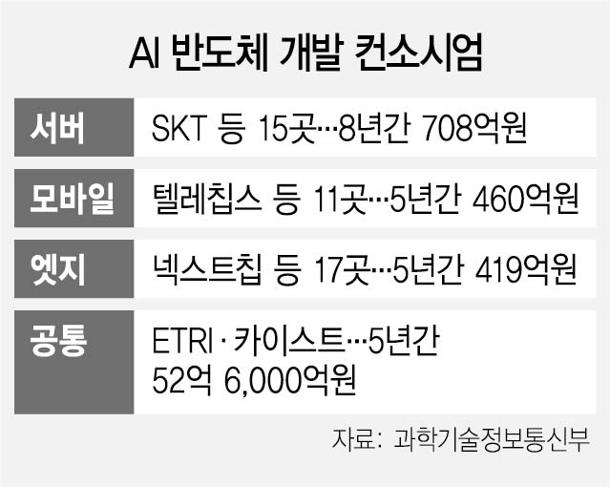
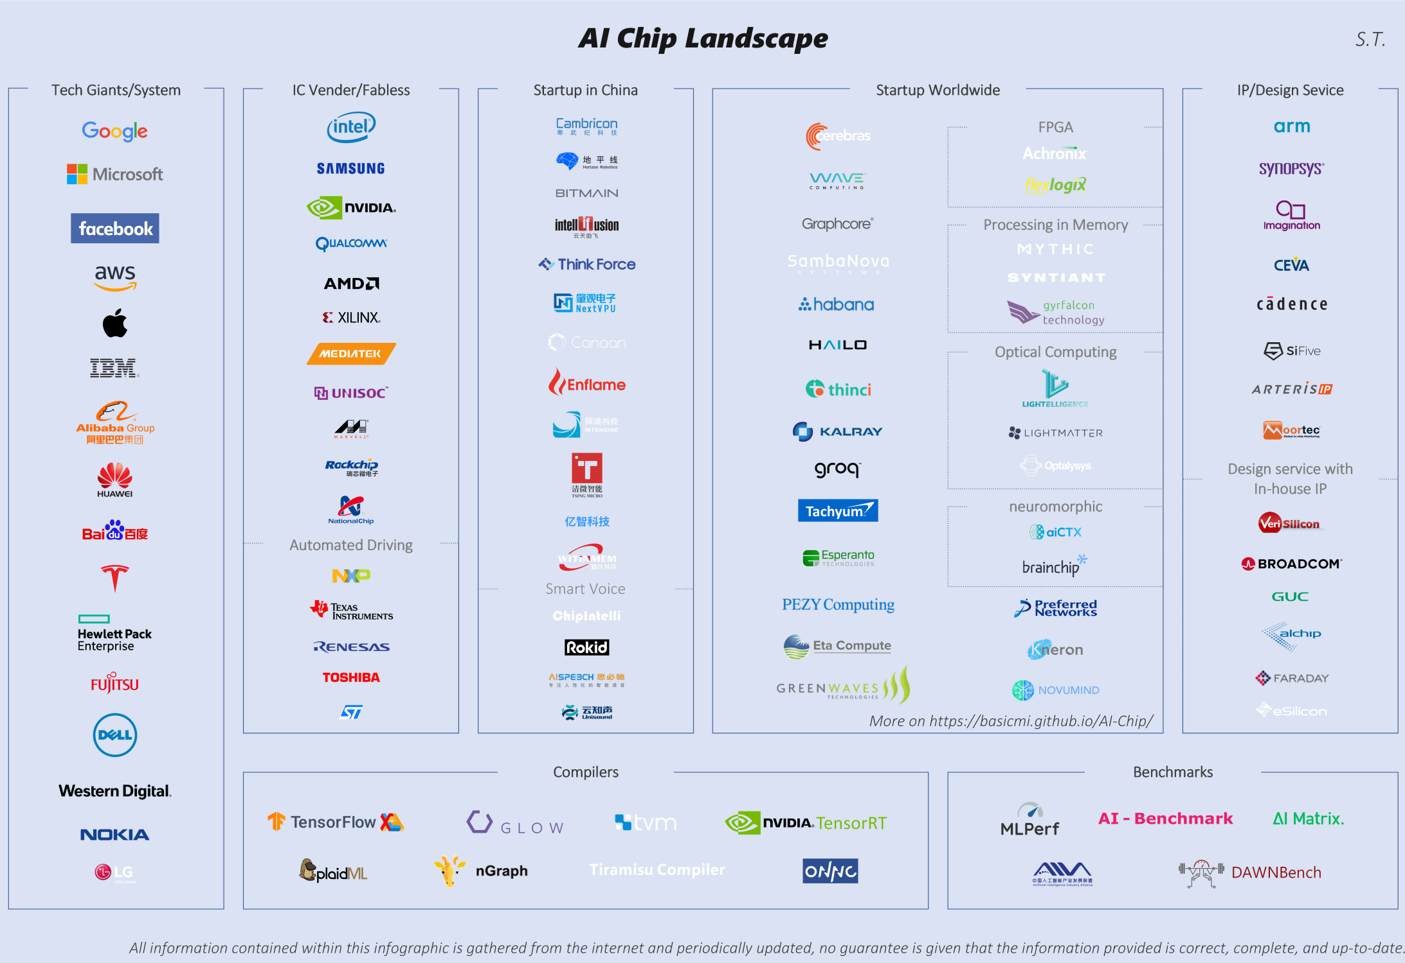
Now is the era of NPU #1
Neural Processing Unit (NPU)
Dedicated accelerator for inference/training neural network
Three mainstreams (ASIC/FPGA, PIM, Neuromorphic)
Neural Network Acceleration Study Season #3
Notes:
The typical approach to micro-architectural design of accelerators is to find a representative workload, extract characteristics, and tailor the micro-architecture to that workload

Slide 4
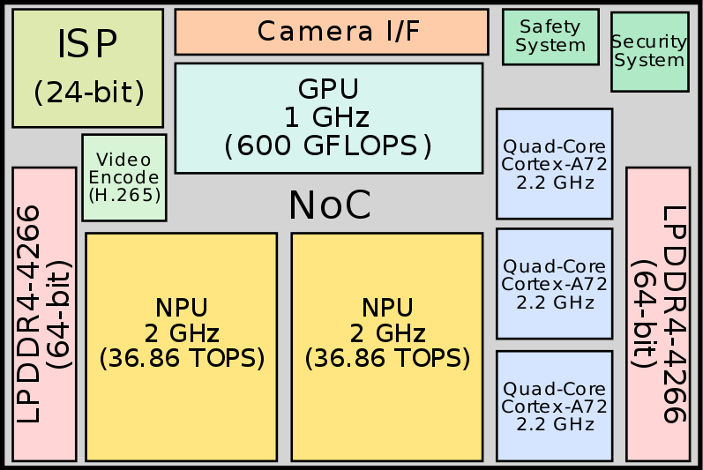
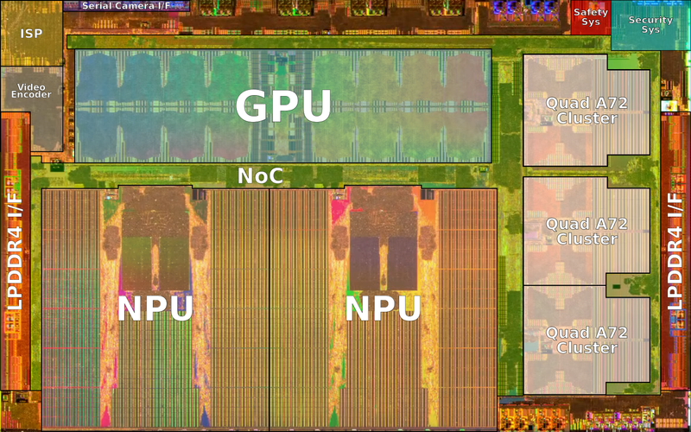
Now is the era of NPU #2
NPU in various place in our lives
Self-driving car: TESLA (FSD Chip)^{[1]}
Home appliance: Samsung, LG (Robotic vacuum, TV, etc.)^{[2]}
Smartphone: AI assistance (Bixby, SIRI), Signal processing
FSD Chip Block Diagram
FSD Chip Die Photo
Neural Network Acceleration Study Season #3
Notes:
The typical approach to micro-architectural design of accelerators is to find a representative workload, extract characteristics, and tailor the micro-architecture to that workload

Slide 5
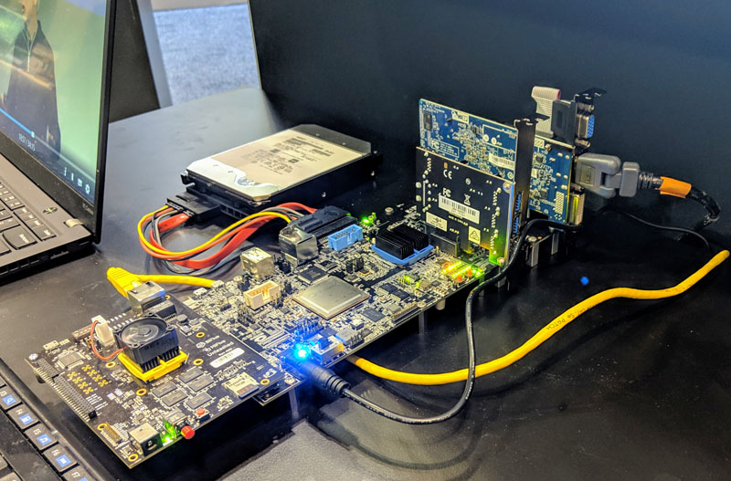
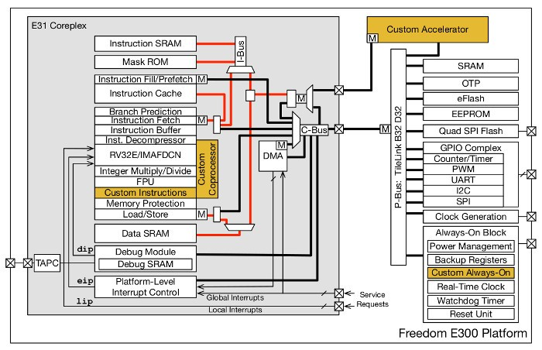
Motivation of paper
Useful platform for research
SoC platform: integration of NVDLA and MCU (RISC-V)
Limitation
High cost of Field programmable gate array (FPGA) (about 7k cost)
Opensource SoC platform not support an L2 cache (limited configuration)
FireSim
Chisel
Neural Network Acceleration Study Season #3
Notes:
The typical approach to micro-architectural design of accelerators is to find a representative workload, extract characteristics, and tailor the micro-architecture to that workload
400 Mbyte/s

Slide 6

SoC platform running on FireSim
DNN accelerator being incorporated into embedded system-on-chips (SoCs)
NVDLA (NVIDIA Deep Learning Accelerator) inside Xavier SoC platform
SiFive’s RISC-V SoC (Rocket Chip), Freedom U540 SoC platform
FireSim: FPGA-accelerated full-system simulator running Amazon cloud FPGAs
We believe SiFive’s integration of NVDLA is especially a useful platform for conducting research thanks to its opensource nature.
Neural Network Acceleration Study Season #3
Notes:
The typical approach to micro-architectural design of accelerators is to find a representative workload, extract characteristics, and tailor the micro-architecture to that workload

Slide 7
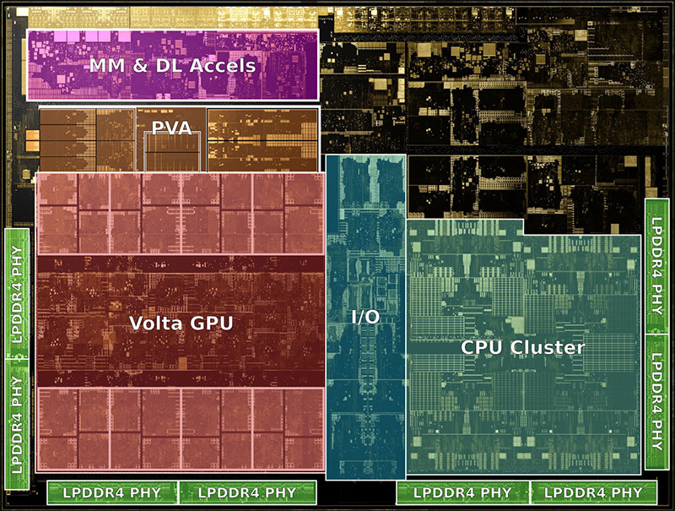
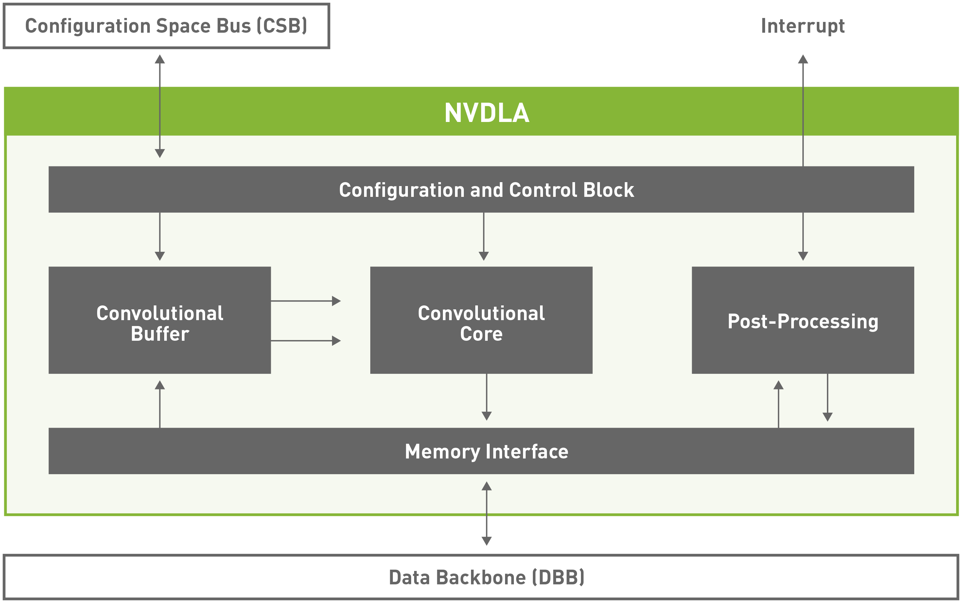
NVDLA (NVIDIA Deep Learning Accelerator)
Microarchitecture designed by NVIDIA for acceleration DNN
Specifically optimized for CNN (workloads deal with images and video)
Targeting edge devices, IoT application, and other lower-power inference designs
Neural Network Acceleration Study Season #3
Notes:
The typical approach to micro-architectural design of accelerators is to find a representative workload, extract characteristics, and tailor the micro-architecture to that workload

Slide 8
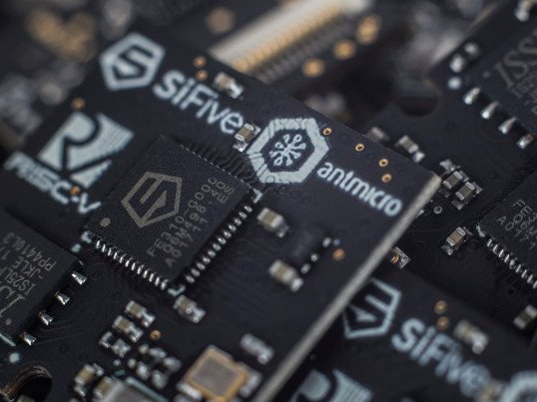
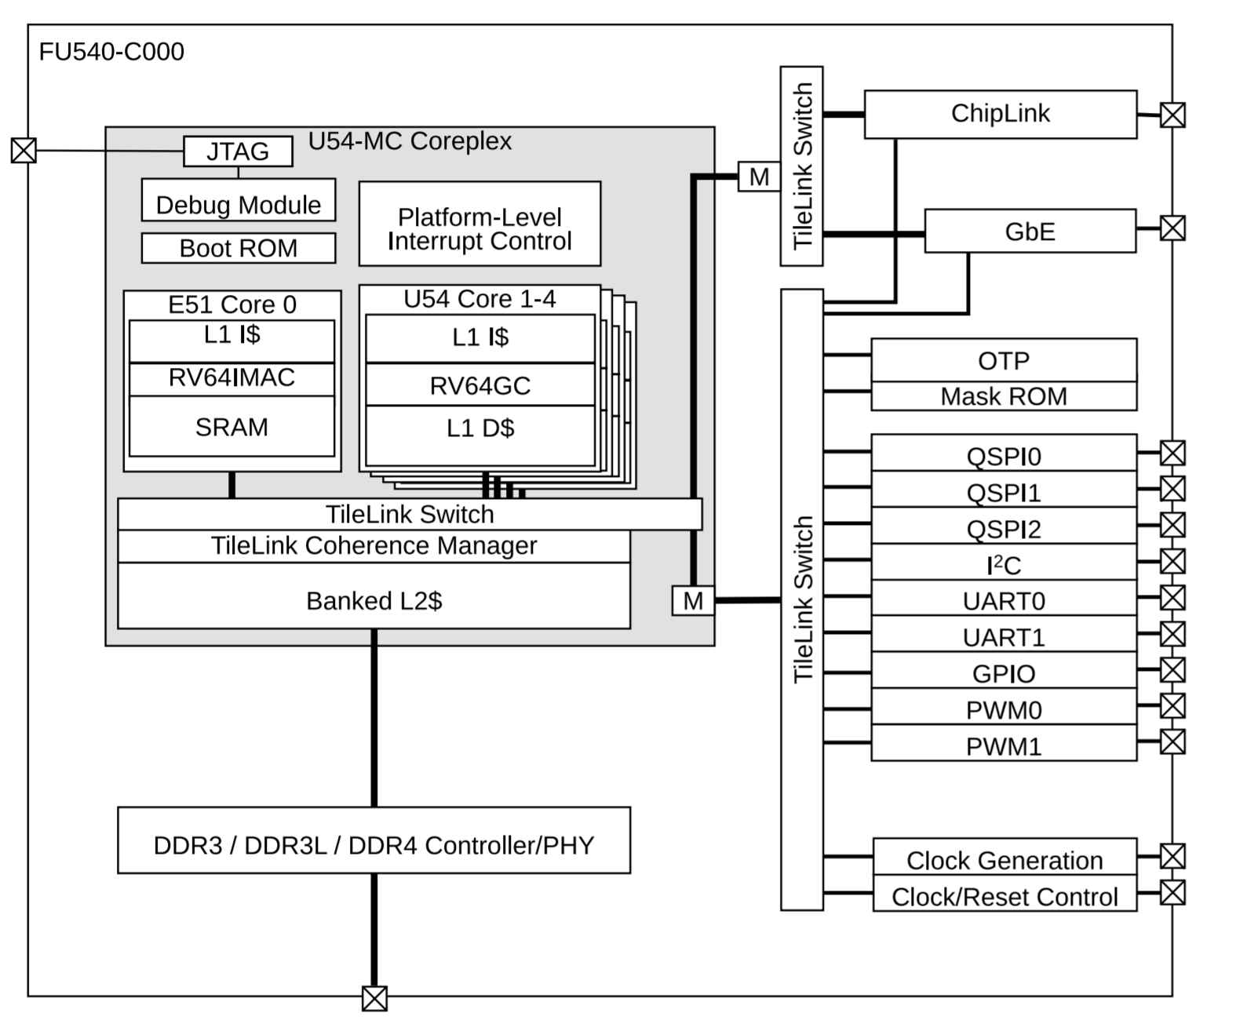
Rocket Chip (NVIDIA Deep Learning Accelerator)
Opensource RISC architecture
Expandable instruction set architecture (ISA) for RISC processor
Inside SSD controller, 5G modem, IoT sensor, power-management IC (PMIC)
Implemented by chisel language
Neural Network Acceleration Study Season #3

Slide 9
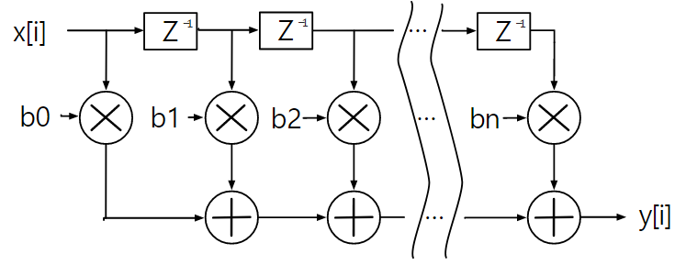
Chisel
HW description language for advanced circuit generation and design reuse
Productive Hardware description language (HDL)
Instance port mapping, Instance reuse
Designer can design hardware architecture like high-level programming (Scala)
class FirFilter(bitWidth: Int, coeffs: Seq[UInt]) extends Module {
val io = IO(new Bundle {
val in = Input(UInt(bitWidth.W))
val out = Output(UInt(bitWidth.W))
})
// Create the serial-in, parallel-out shift register
val zs = Reg(Vec(coeffs.length, UInt(bitWidth.W)))
zs(0) := io.in
for (i <- 1 until coeffs.length) {
zs(i) := zs(i-1)
}
// Do the multiplies
val products = VecInit.tabulate(coeffs.length)(i => zs(i) * coeffs(i))
// Sum up the products
io.out := products.reduce(_ + _)
}
Neural Network Acceleration Study Season #3

Slide 10
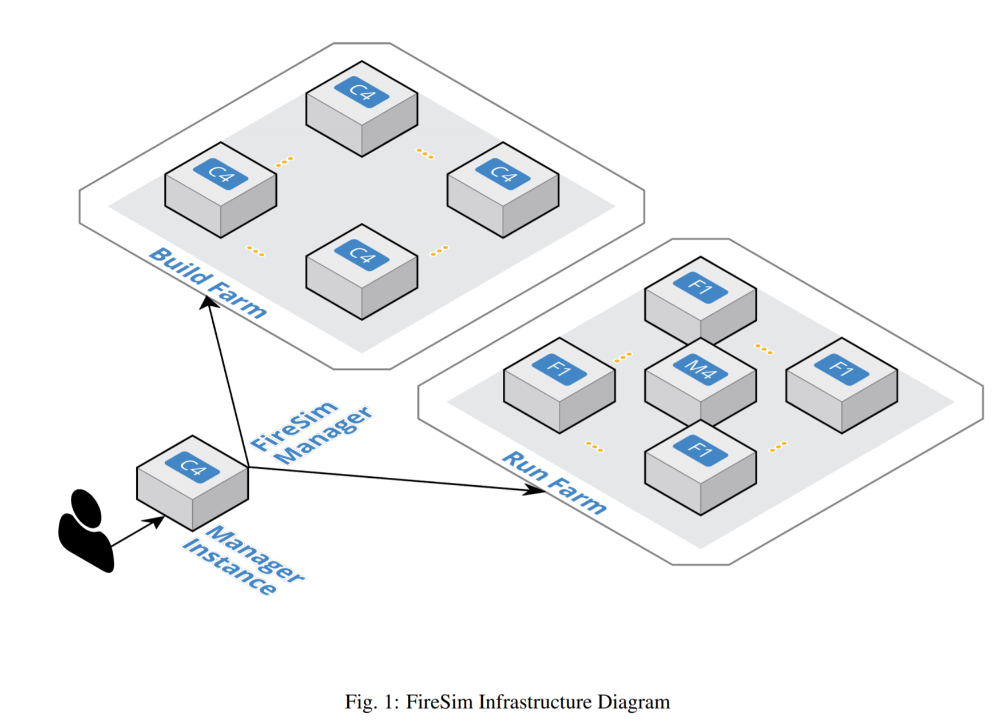
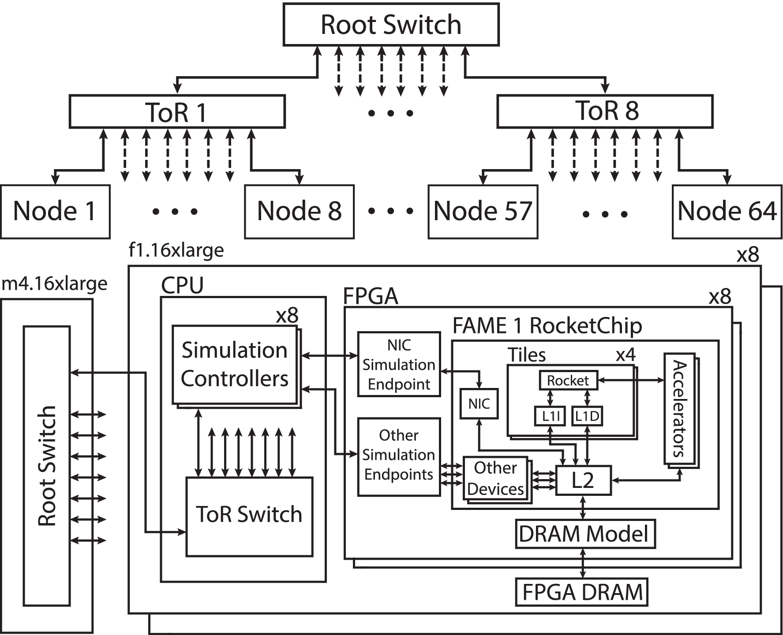
FireSim
FPGA-accelerated cycle-accurate HW simulation in cloud
Running HW design at near-FPGA-prototype speeds on cloud FPGAs
Obtaining cycle-accurate performance results (10~100s of MHz frequency)
Rate for on-demand access ($1.65 per hour)
Neural Network Acceleration Study Season #3

Slide 11
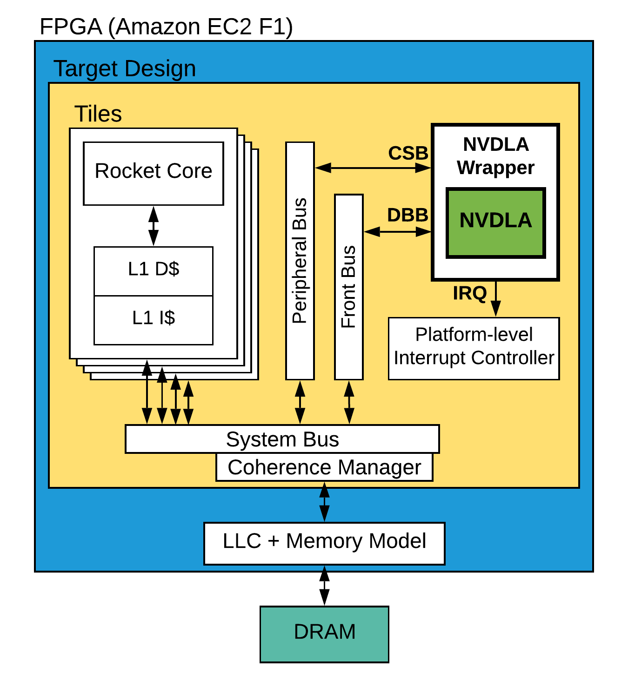
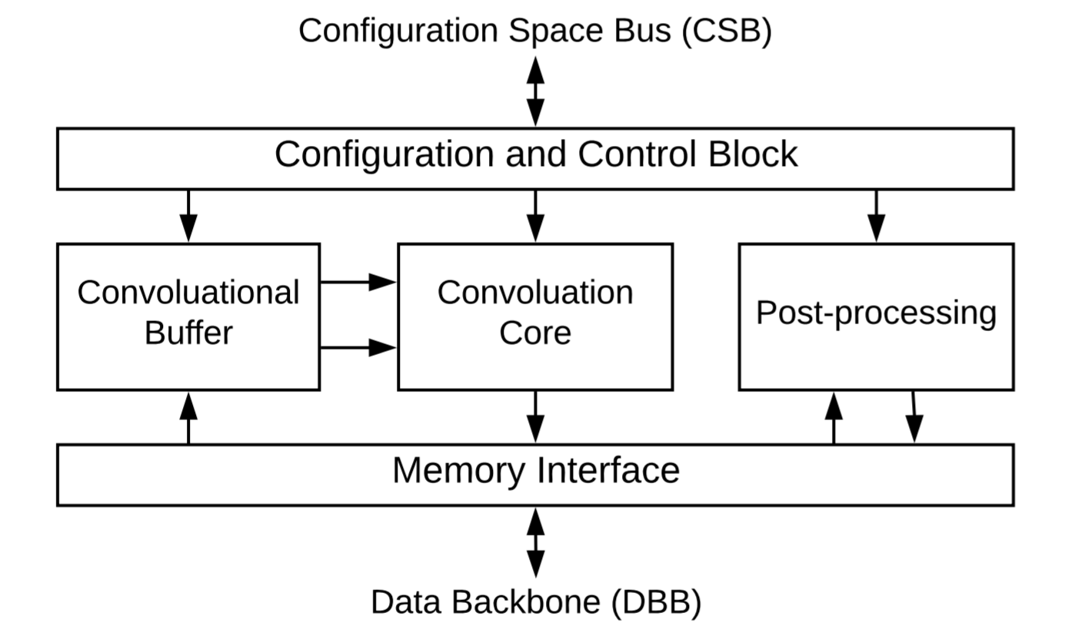
Key contribution: NVDLA integration
NVIDIA DLA (NVDLA)
Buffer (feature map, weight), Core (MAC units), Post-processing (activation, pooling)
AMBA* based design, Control signal (CSB), Data signal (DBB)
NVDLA integration
TileLink based bus protocol, Bride connection (Peripheral, Front)
Configurable LLC and Memory Model (# of sets, ways, and block size)
Neural Network Acceleration Study Season #3

Slide 12
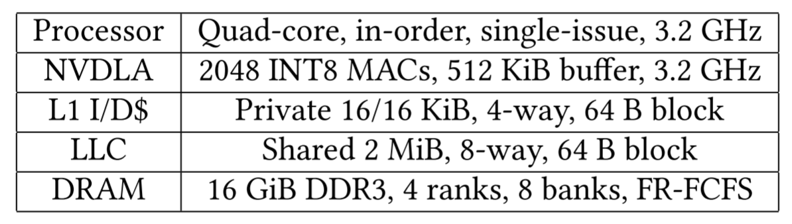
Performance Analysis #1
Experiment Environment
Benchmark: YOLO v3 object detection algorithm
66 billions operation to process 416 by 416 frame
Be operated at lower frequency
NVDLA block is clocked at the same frequency with the processor (FPGA)
Baseline config
Quad-core Rocket Core, 3.2GHz with 2048 INT8 MACs (FP <-> INT8)
Neural Network Acceleration Study Season #3

Slide 13
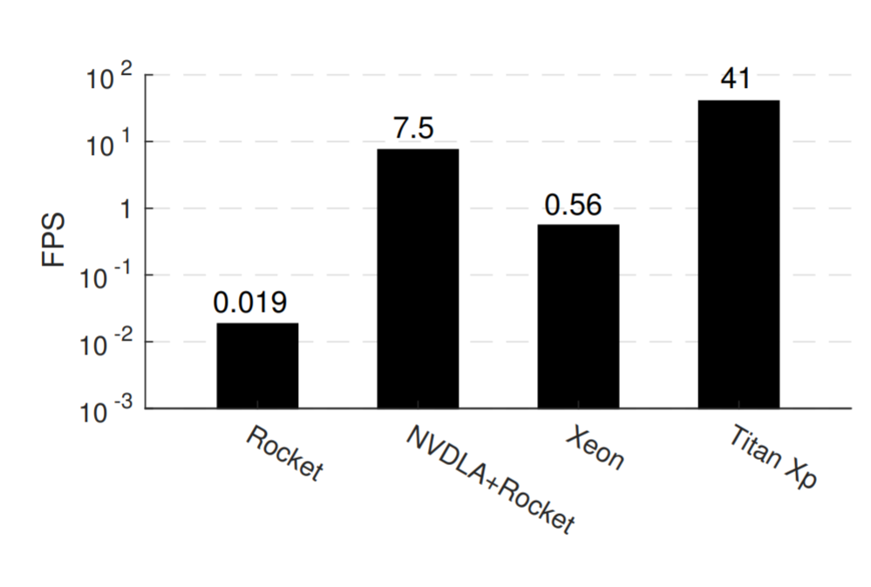
Performance Analysis #2
Performance comparison
Baseline performance of NVDLA
67ms on NVDLA + 66ms on processor (multithreaded with OpenMP)
Layers not supported by NVDLA are running on processor
Titan consumes more power
Titan Xp: 250W (TDP), 471mm² in 16nm technology
NVDLA: 766mW, 3.3mm² in same technology
3840C
24C
4C
Neural Network Acceleration Study Season #3

Slide 14
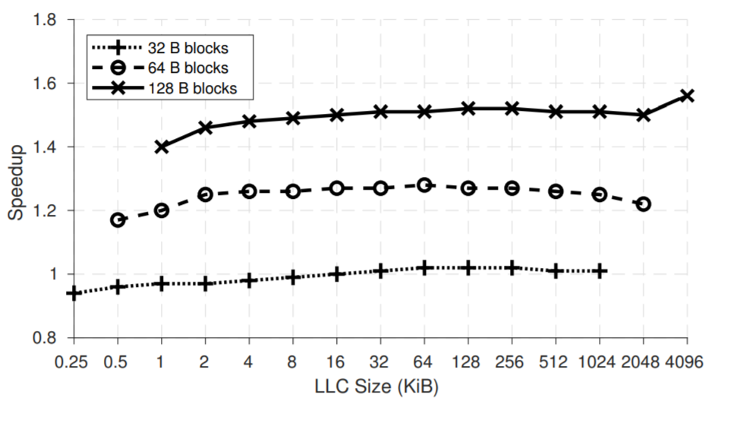
Performance Analysis #3
Effect of Last-level Cache on Performance
Sharing LLC can be good alternative to scratchpad
Chip area saved, less programming effort
Varying LLC size and measuring NVDLA speedup
Also, size of cache block (32B, 64B, and 128B)
NVDLA is not very sensitive to LLC size
Temporal locality in NVDLA memory accesses pattern
Target>Minimum burst length (32B), reducing latency
Hardware prefetching improving NVDLA performance
Benefit of sharing LLC capturing spatial locality
1.59x
3840C
24C
4C
Neural Network Acceleration Study Season #3

Slide 15
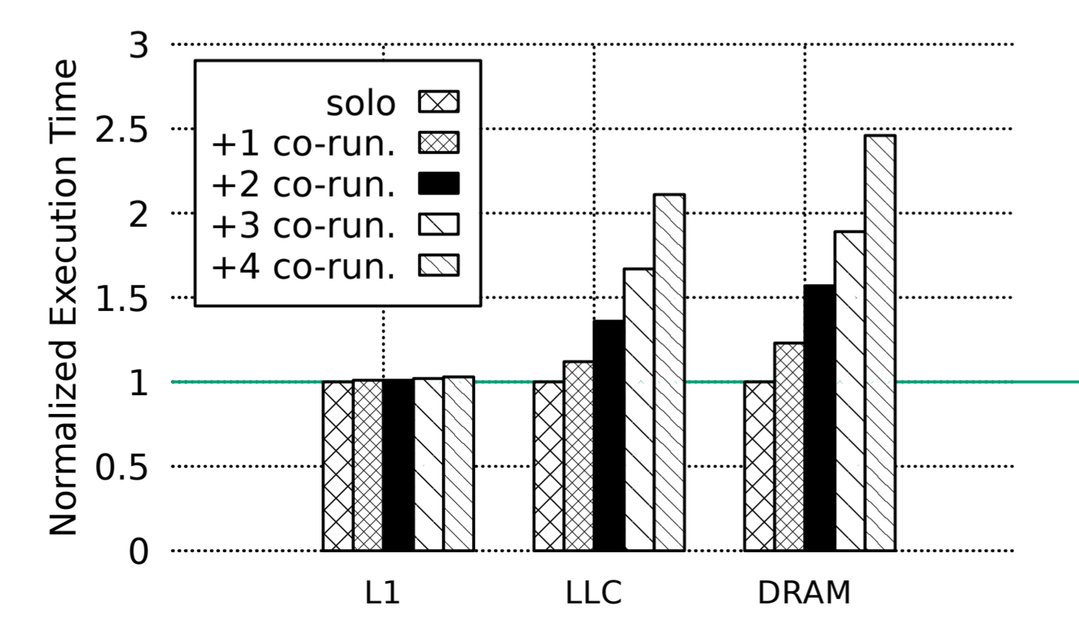
Performance Analysis #4
Effect of Shared Memory Interference
NVDLA and CPU are sharing memory system
Interference with one another when accessing the memory
Unpredictable latency in execution of tasks running on NVDLA
Bandwidth Write (BwWrite) benchmark to study interference caused by processor
Co-schedule BwWrite with YOLO v3 running on NVDLA
L1 cache (No slowdown)
Own private data cache and WSS
LLC and DRAM: 2.5x for co-runners
3840C
24C
4C
Neural Network Acceleration Study Season #3

Slide 16
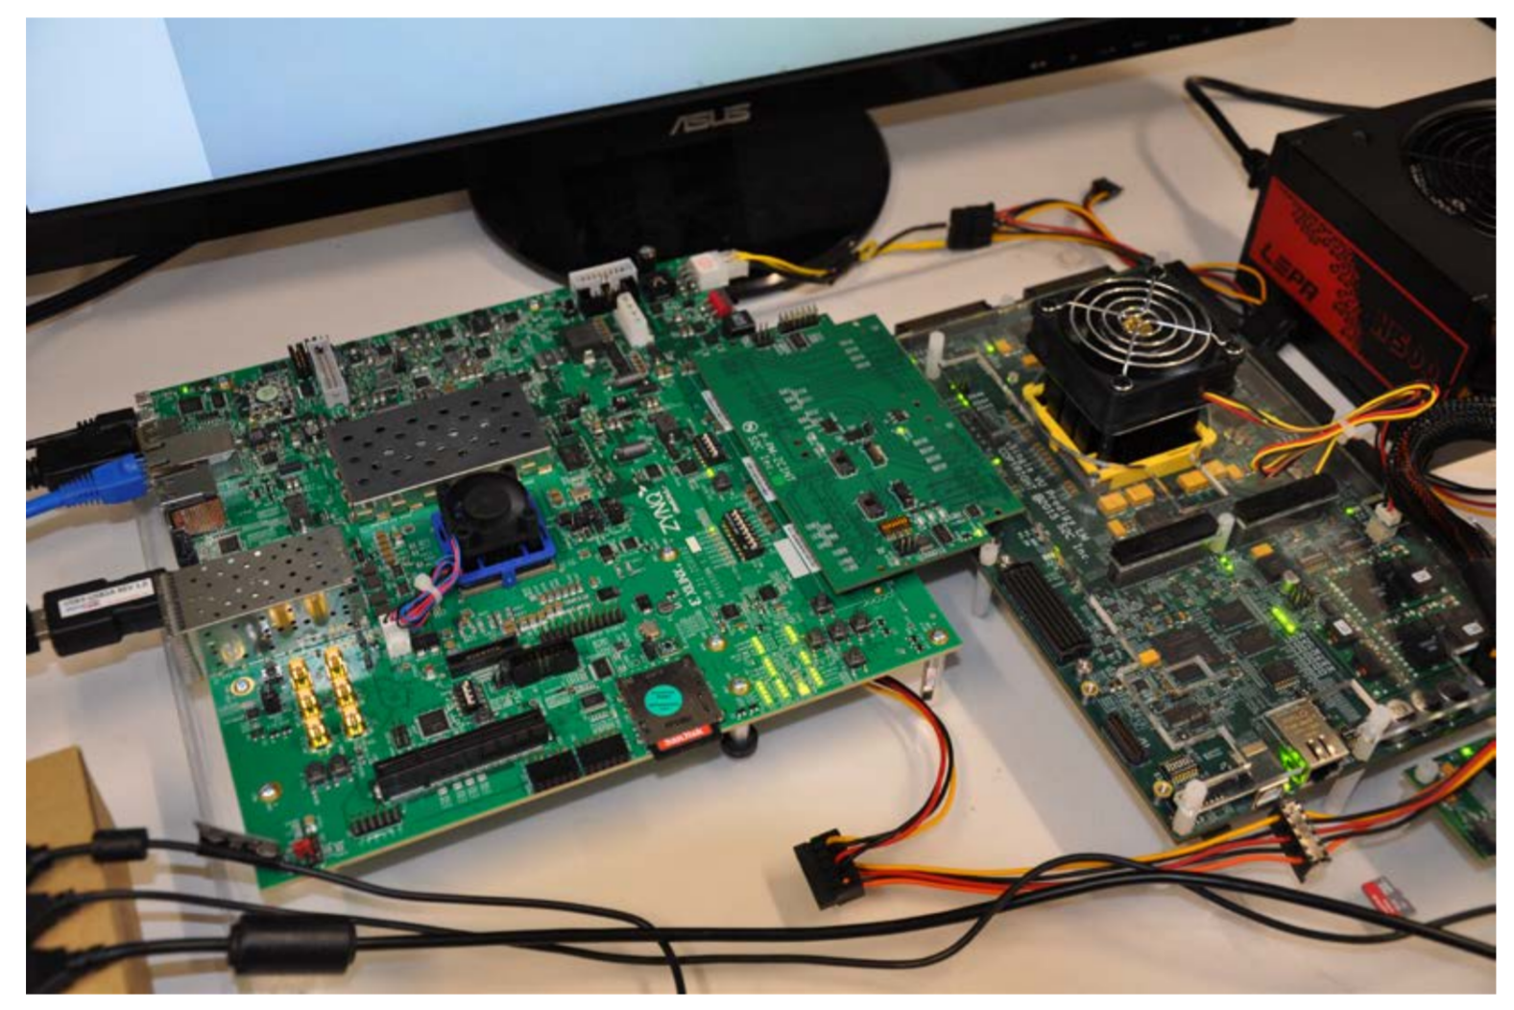
Conclusion
First integration platform of RISC-V + NVDLA
NVDLA provides good acceleration performance, especially considering its low power consumption
Larger cache block size and/or hardware prefetcher is desirable for performance
Impact of shared memory interference between CPU and NVDLA is significant
3840C
24C
4C
Neural Network Acceleration Study Season #3

Slide 17
Thank you
Neural Network Acceleration Study #2
Notes:
46.2/278

